Slide 1
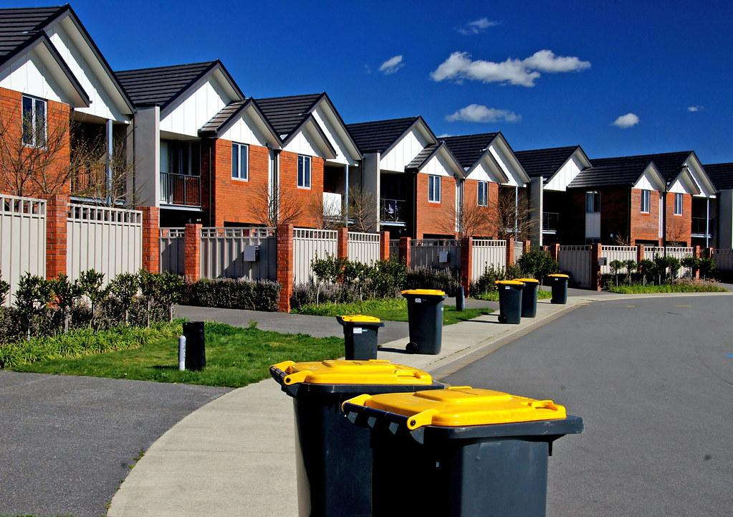

Playbook Pitch
Brett Chevalier, Charles Lazimi, Annalina Becker, Shaila Patel, Jaeyong Sin, and Johnny Li

Slide 2

PROBLEM
Trash is often not dealt with immediately when it becomes odorous, thereby negatively affecting the quality of life of the immediate persons surrounding it. In cases where the trash bag isn’t full and ready to be disposed of, the odor is still accumulating due to the breakdown of organic material, such as food waste. This is not only an issue of comfort for people, but is also an issue as it can attract pests.
Odor from trash often results from…
Gases (eg. sulfur, methane, etc), released from organic decomposition
Mixing of various substances or liquids
Neglecting removal for a prolonged period of time
Notes:
The bag might not be full but it still accumulates odor - the only option at this point would be to change the bag, wasting it. Our product resolves this issue

Slide 3

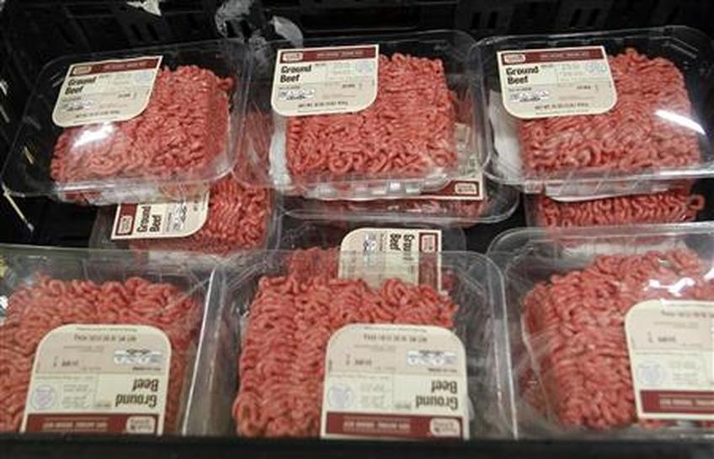
BACKGROUND INFO
Organic waste can make up ~70% of the total flow of waste.
Odor stems from the subsequent bacterial breakdown of these organics.
This odor is dependent on the compound’s individual odor threshold (the amount at which we can physically smell it).
Sulfur-containing compounds give off a rotten egg or cabbage type smell
Low odor threshold
Nitrogen-containing compounds such as amines & cadaverine stem from meat decomposition
High odor threshold
Plastic packaging on meats
.
Notes:
more market research

Slide 4
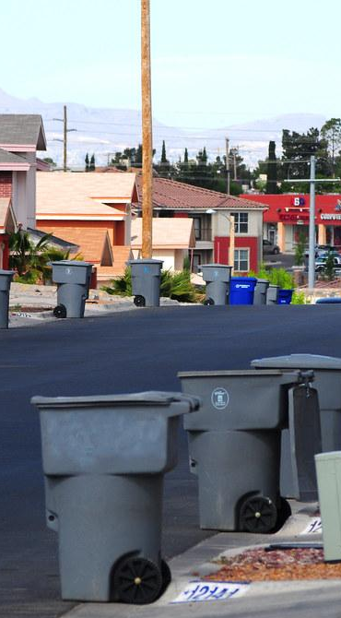
NEED STATEMENT
“There is a need to decrease odor from trash in residential and high traffic commercial areas.”

Slide 5
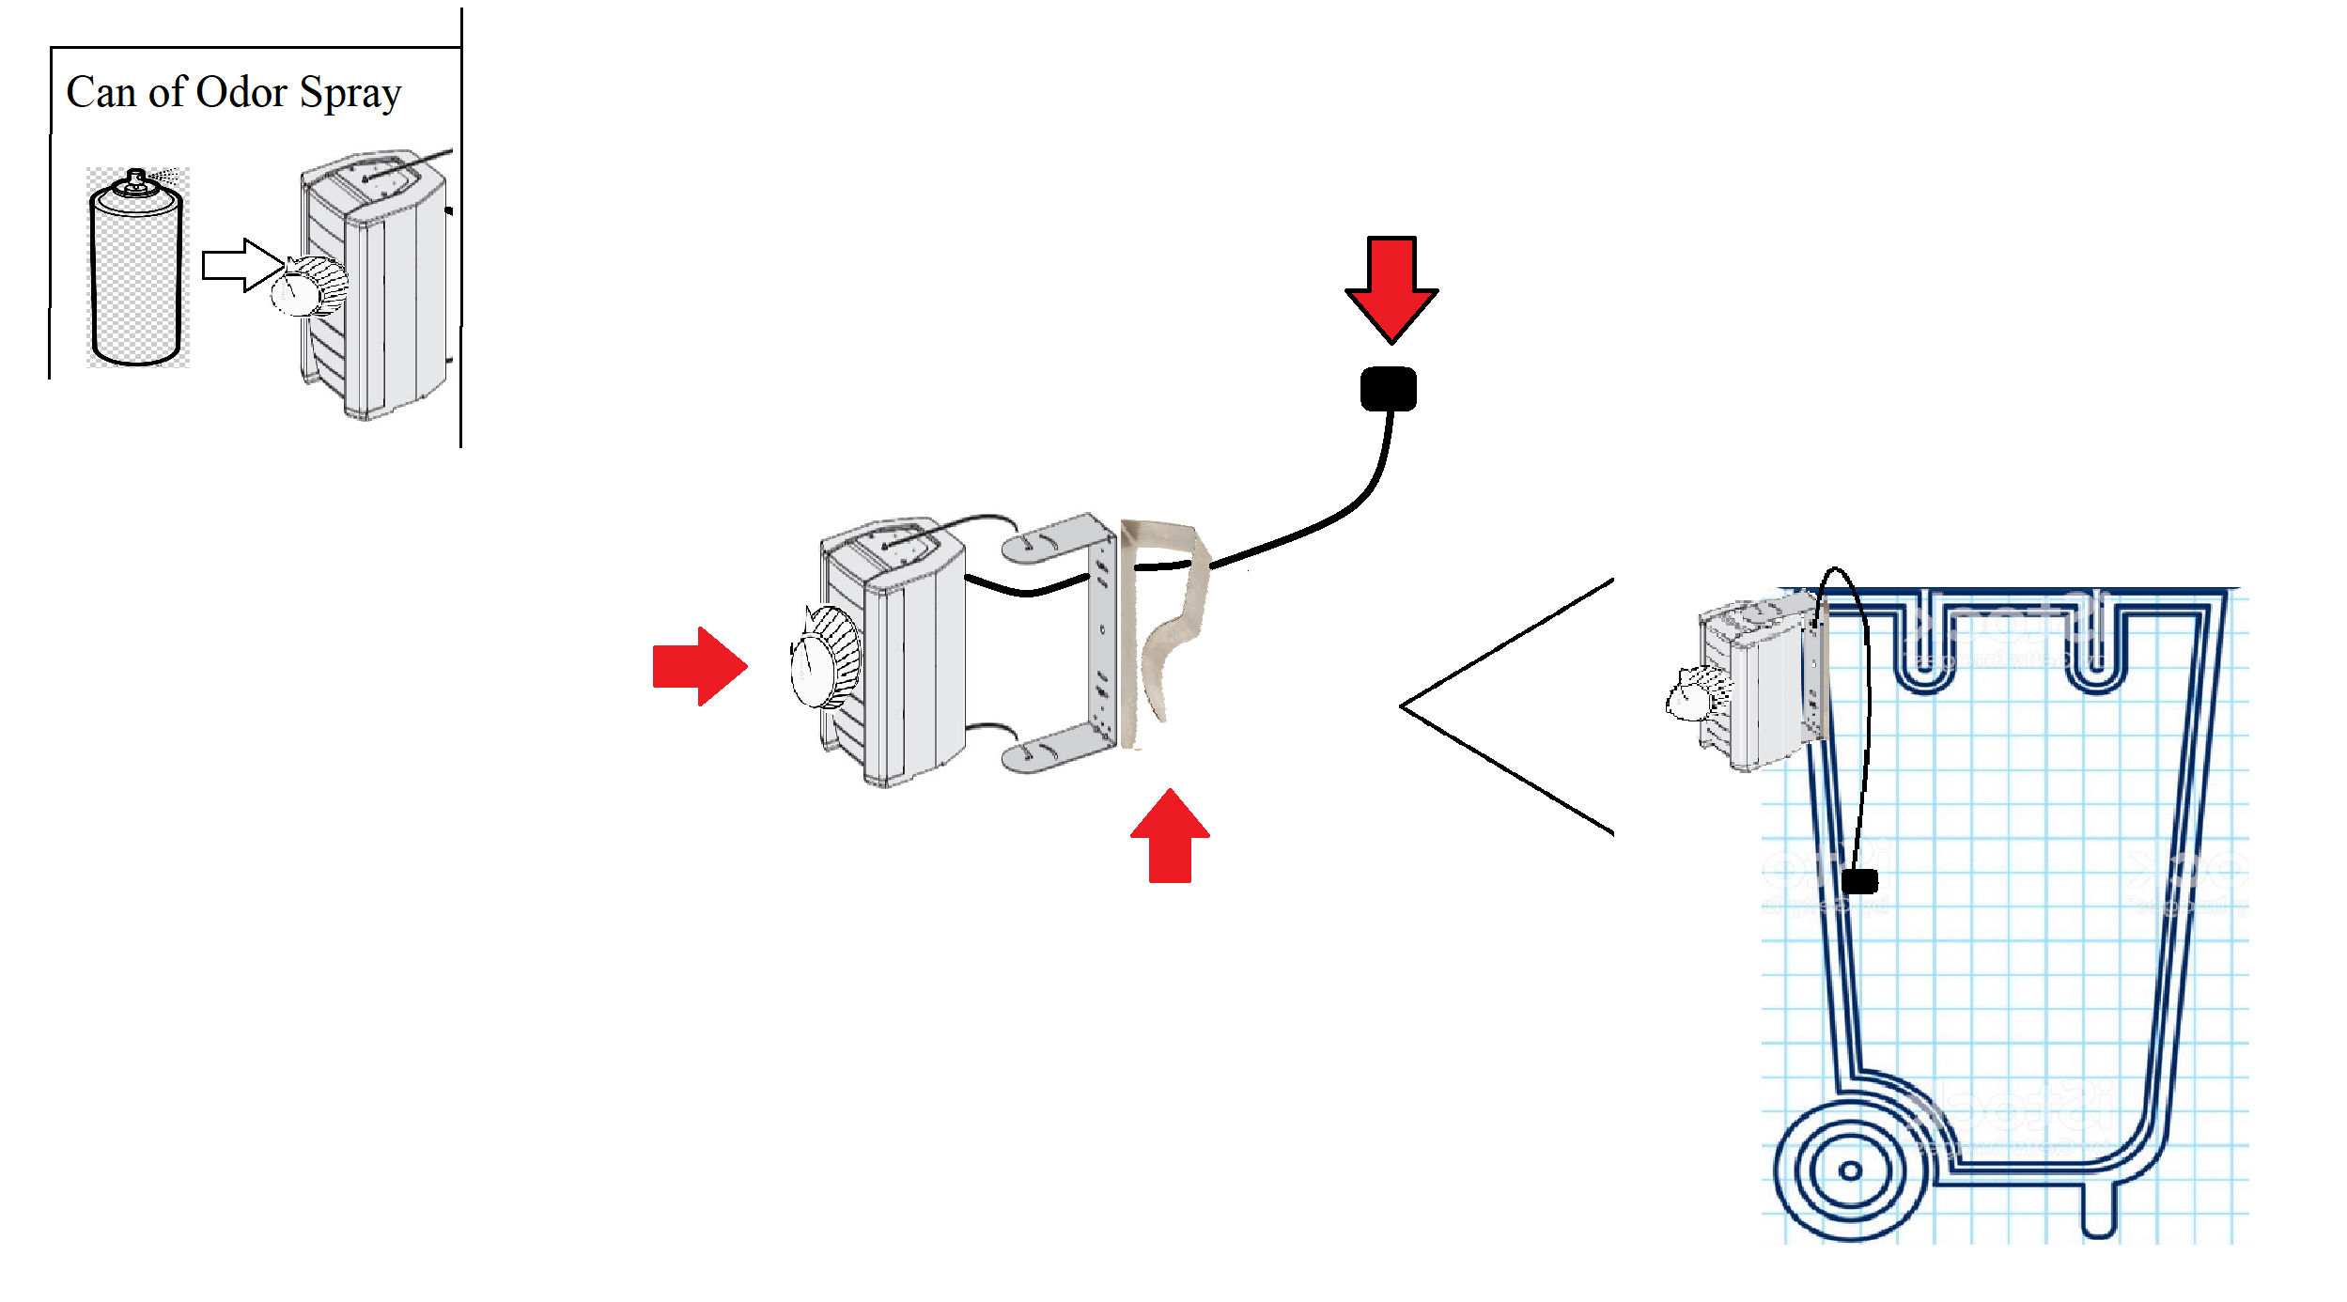
SOLUTION
Odor Buster
Odor Sensor and spray output nozzle
Adjustable odor threshold dial
Clip
Our product detects and eliminates odor in trash cans before it surpasses the threshold set by the user
*Not to scale.

Slide 6
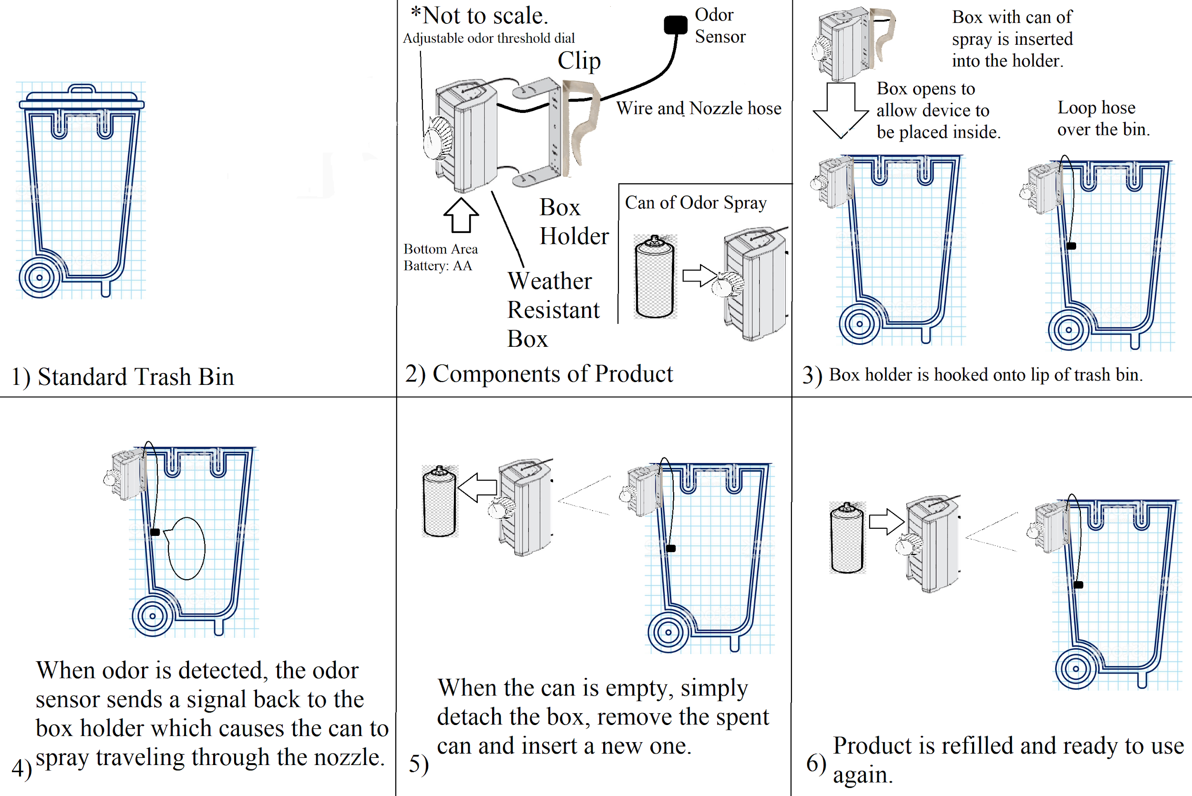
DESIGN USE

Slide 7
ODOR DETECTOR COMPONENTS
Aerosol Spray/Can Components
Includes a hypochlorite disinfectant solution.
Will use natural propellants such as compress gasses (eg. carbon dioxide and nitrous oxide).
Spray solution that combats smell inducing agents.
Solution: mixture of distilled water, essential oil, witch hazel, and baking soda.
Neutralizes odor.
Canister will be made out of recyclable materials.
Notes:
hypochlorite disinfectant- bleach solution

Slide 8
ODOR DETECTOR COMPONENTS
Detector Components
Utilize a compact smell sensor, like Aroma Bit SDK-1Q, to detect the chemical components in the air and determine odor quality.
Sensor would be attached to a microcontroller.
Powered through AA batteries.
Smell sensor should be placed near the centerline of the trash bin.
The detector will trigger the can to release spray once the odor suprasses a threshold.
Threshold is set through a dial on the box which controls the setting on the microcontroller.
To address the trash blocking, the spray output nozzle is placed inside the black box preventing it from being blocked, the black box can be porous/ grated so the spray can diffuse out.
Spray 3.5 ml of solution per trigger and will resample the odor in 10 mins to see if another spray is needed.

Slide 9
FEASIBILITY & VIABILITY
Technology
Our product is unique and as of now, an exact replica does not exist on the market.
Market
We have a focused market and are aimed towards selling to householders, restaurant owners, and anyone who faces the problem of smelly trash.
Customer
We do not have a dedicated customer base as of now, however, we would be willing to listen to what the customers need and act to make improvements to the product.
Team/Ability to Execute
We are a talented team, however we do not have a chemical engineer, and the spray that is contained within the canister will need to be tested by someone who has a background in chemical engineering.

Slide 10
TIMELINE AND ACTION PLAN
Test the Prototype
Launch the product
Create a High Fidelity Prototype
Talk to potential sponsors
What: Finalize the design of the canister, what it will be made out of, what the spray is made of, and the mechanism of the smell detector.
Who: Team + Chemical Engineers
When: 4 months
Resources: A design lab, money
Success: A successful high-fidelity prototype built
(may need to come back to this step depending on the next step)
What: Testing the prototype and collecting the data to determine its success. they will be using it over a long period of time.
Who: Volunteers from hoi polloi and the team
When: 2 months
Resources: Excel to keep track of the data, copies of the prototype.
Success: Gather enough data to know exactly what needs to be changed before moving on.
What: Talk to investors to collect funds to start the project.
Who: The team + investors
When: 6 months
Resources: Team, pitch, a network of people
Success: Enough money to manufacture the products, and distribute them to retailers.
What: Manufacture and sell it to distributors.
Who: Team + Retailers such as Amazon and Walmart
When: 9 months
Resources: A manufacturing strategy, funds, and connections with different retailers.
Success: Build a user base of 100,000 people
.

Slide 11


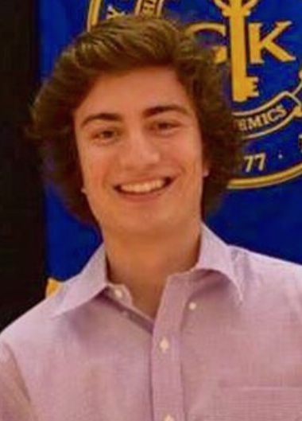
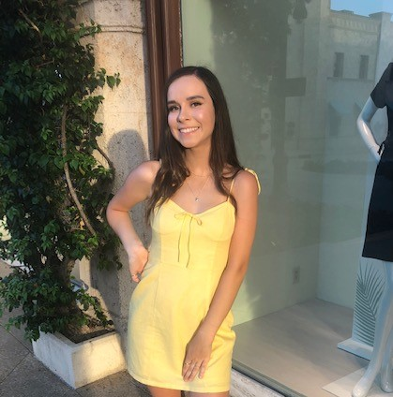


OUR TEAM
Brett Chevalier
Undergraduate
Bachelor’s
Computer Science
Johnny Li
Undergraduate
Bachelor’s
Computer
Engineering
Charles Lazimi
Graduate
Masters
Biomedical Engineering
Annalina Becker
Undergraduate
Bachelor’s
Electrical
Engineering
Jaeyong Sin
Undergraduate
Bachelor’s
Computer Science
Shaila Patel
Undergraduate
Bachelor’s
Computer Science

Slide 12

QUESTIONS?

